Slide 1
Using SakaiPlus in Canvas

Slide 2
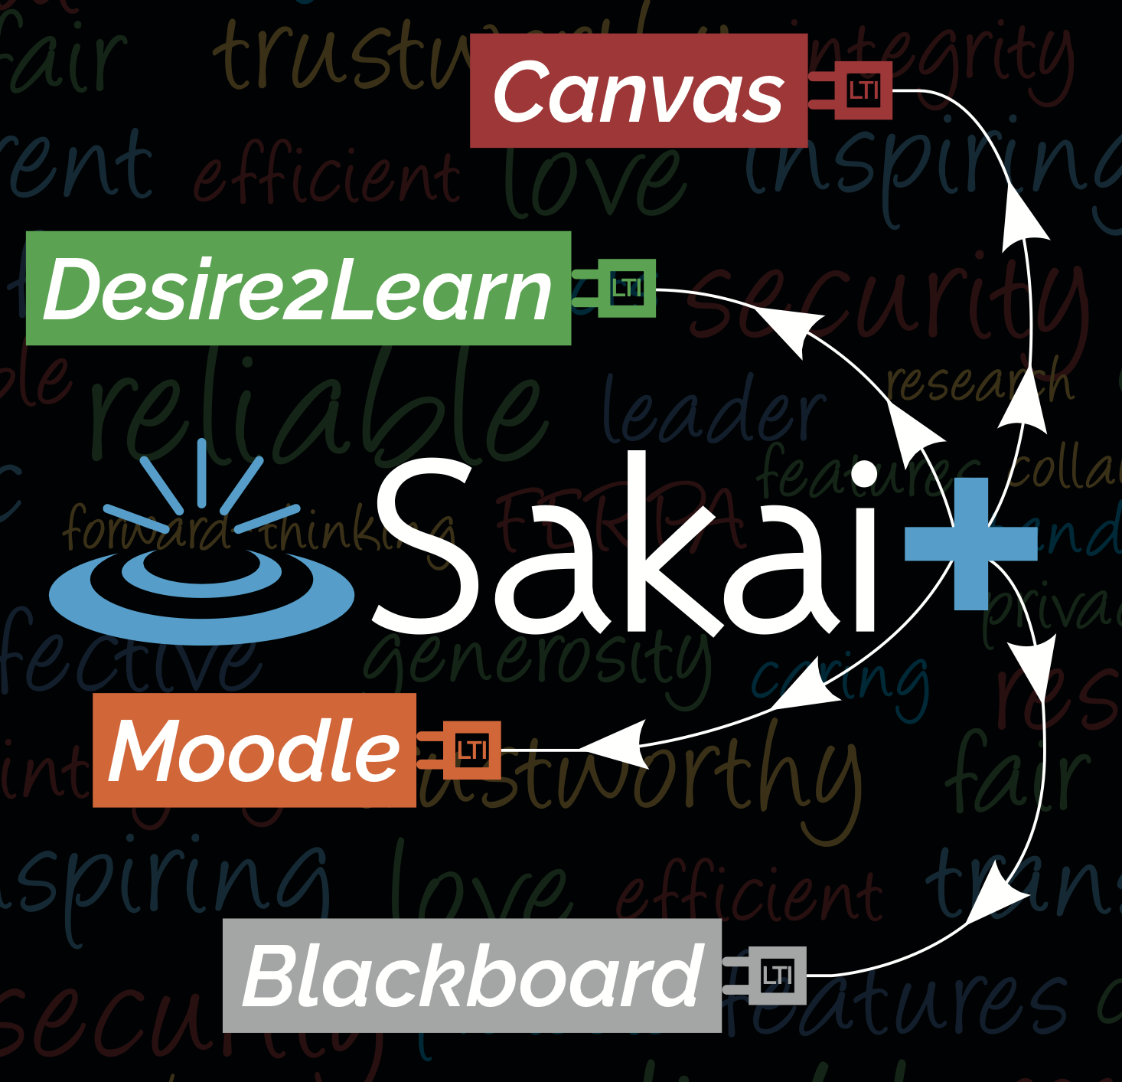
SakaiPlus TL;DR
Plugs an entire LMS into an Enterprise LMS with a single link
Rosters and Grades are synchronized using LTI Advantage
Cost and IT Support are on par with a single LTI Tool
Give your innovative faculty a choice

Slide 3
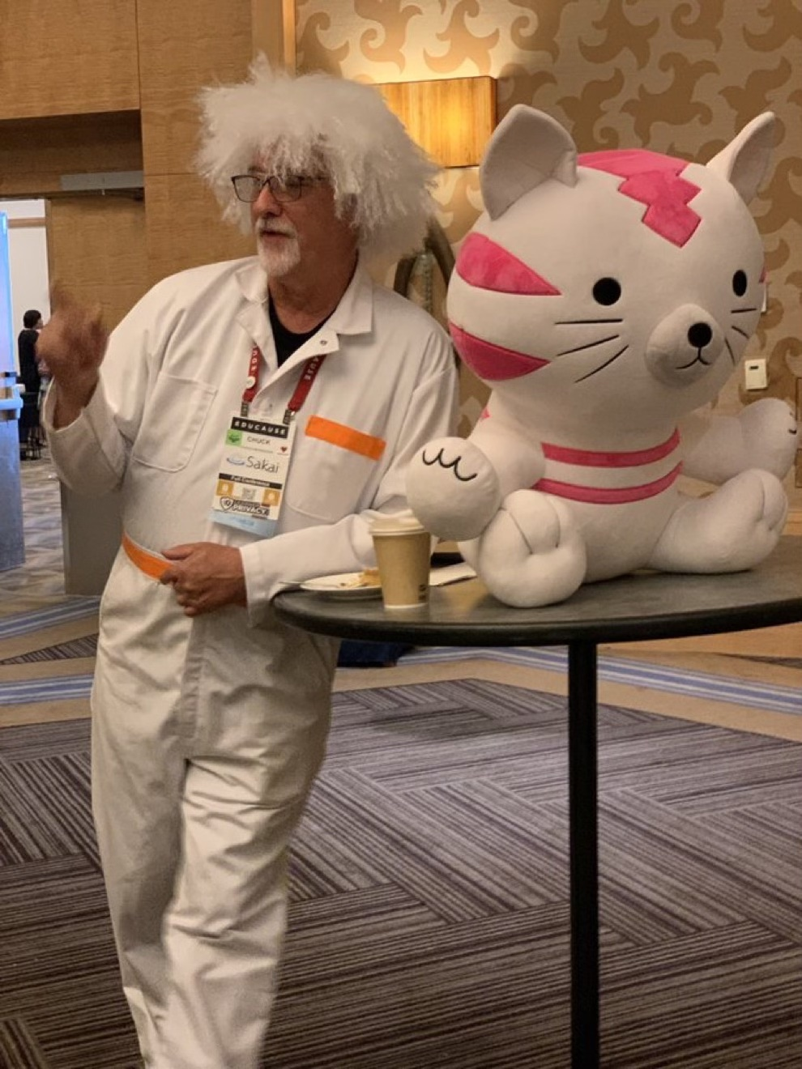
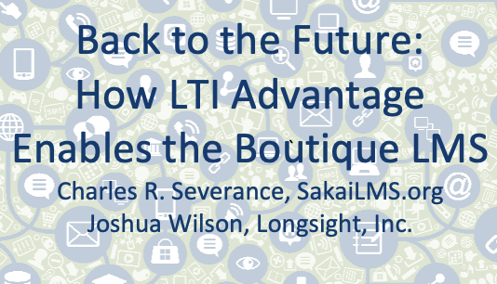
A Year Ago

Slide 4
Start with a Demo

Slide 5
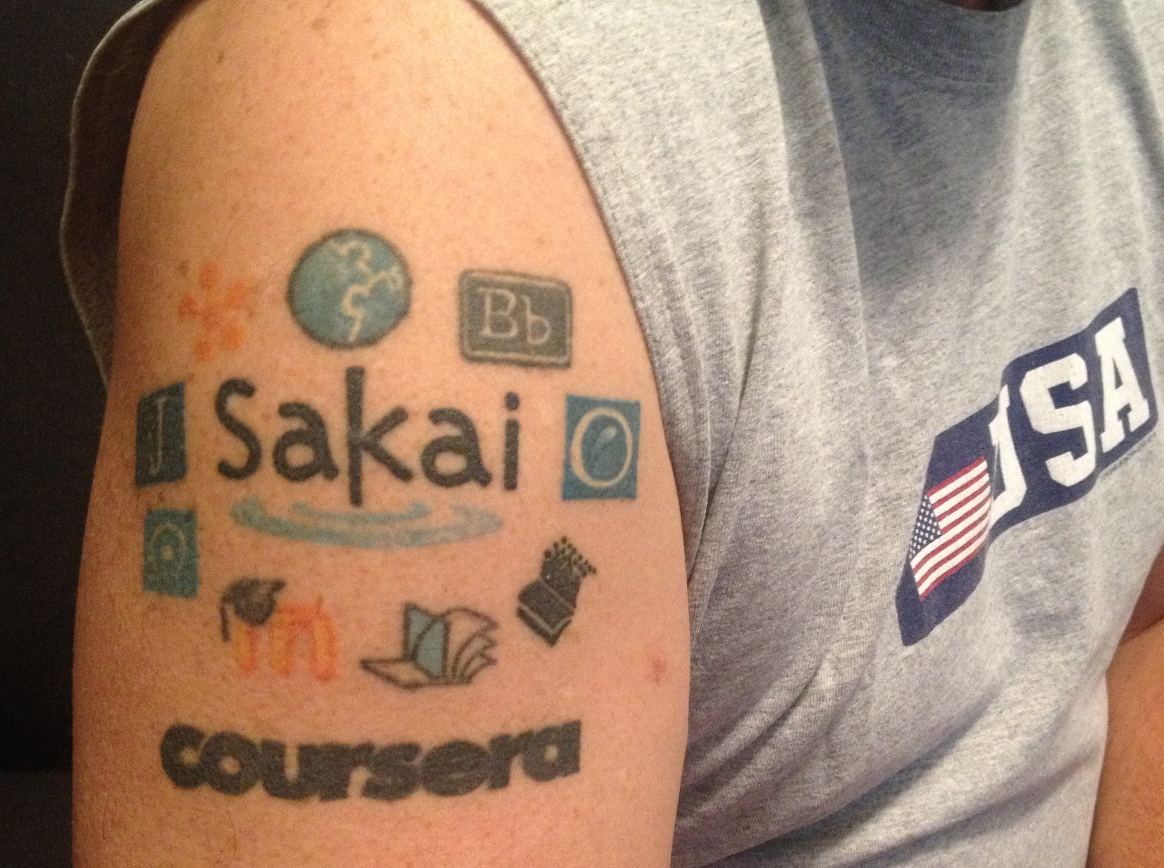
Dr. Chuck
Co-Founder Sakai 2004
Founded Learning Tools Interoperability (LTI) 2004
Founded Common Cartridge (2006)
Faculty member University of Michigan School of Information 2007-present
MOOC Innovator – Coursera 2014
Current Chair of the Sakai PMC

Slide 6
SakaiPlus @ University of Michigan
Initial Development and Testing – 2021
Summer 2022
Approval for limited production use in the School of Information
Privacy training
Hosted on UMich-owned AWS resources
Fall 22 – Sakai 22+Beta – One Course
Winter 23 – Sakai 23+Beta – Three Courses
Summer 2023 – Released in Sakai 23

Slide 7
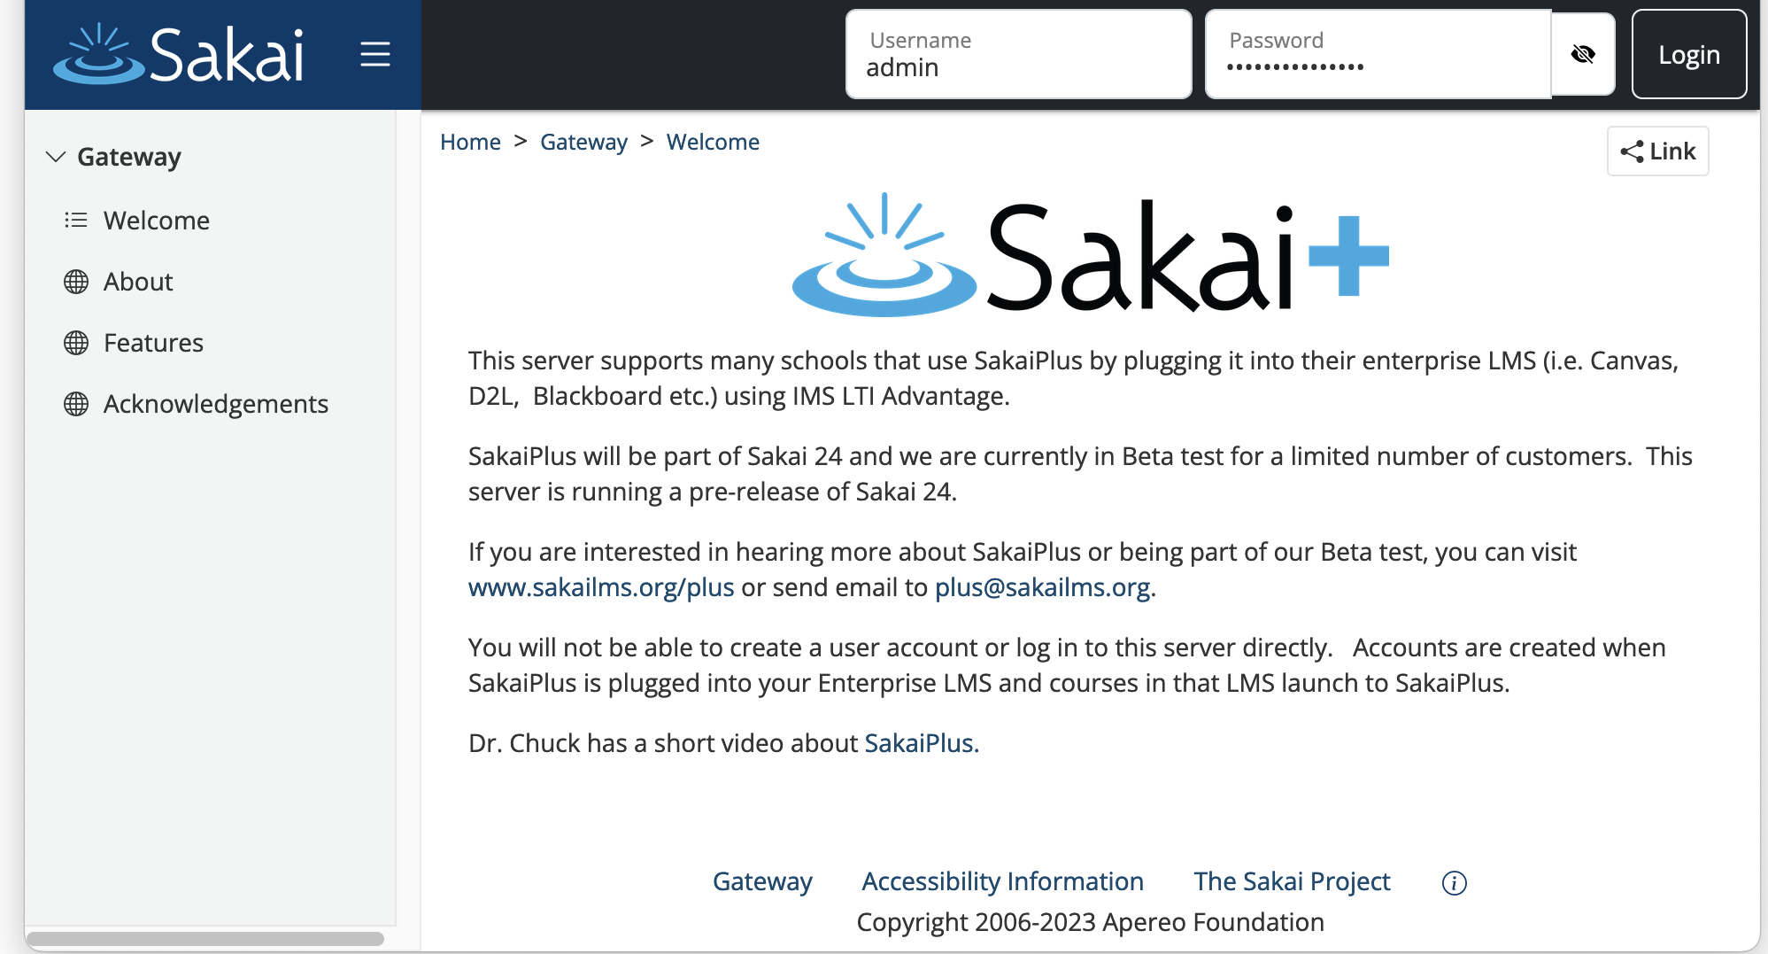
https://plus.sakaicloud.com – Beta Ready

Slide 8
SakaiPlus Philosphy
No local customization
Easy Upgrades
AMI Subscription

Slide 9
Living inside the Enterprise LMS
Upgrade early and often – track the latest
Less concern regarding performance and scaling
No standup meetings ☺
Always can fall back to the enterprise LMS – Hybrid (Screen shot of modules - from Fall 23)

Slide 10
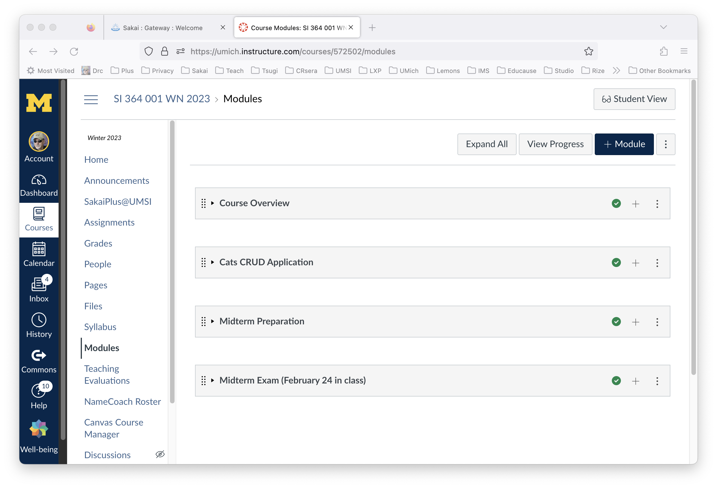
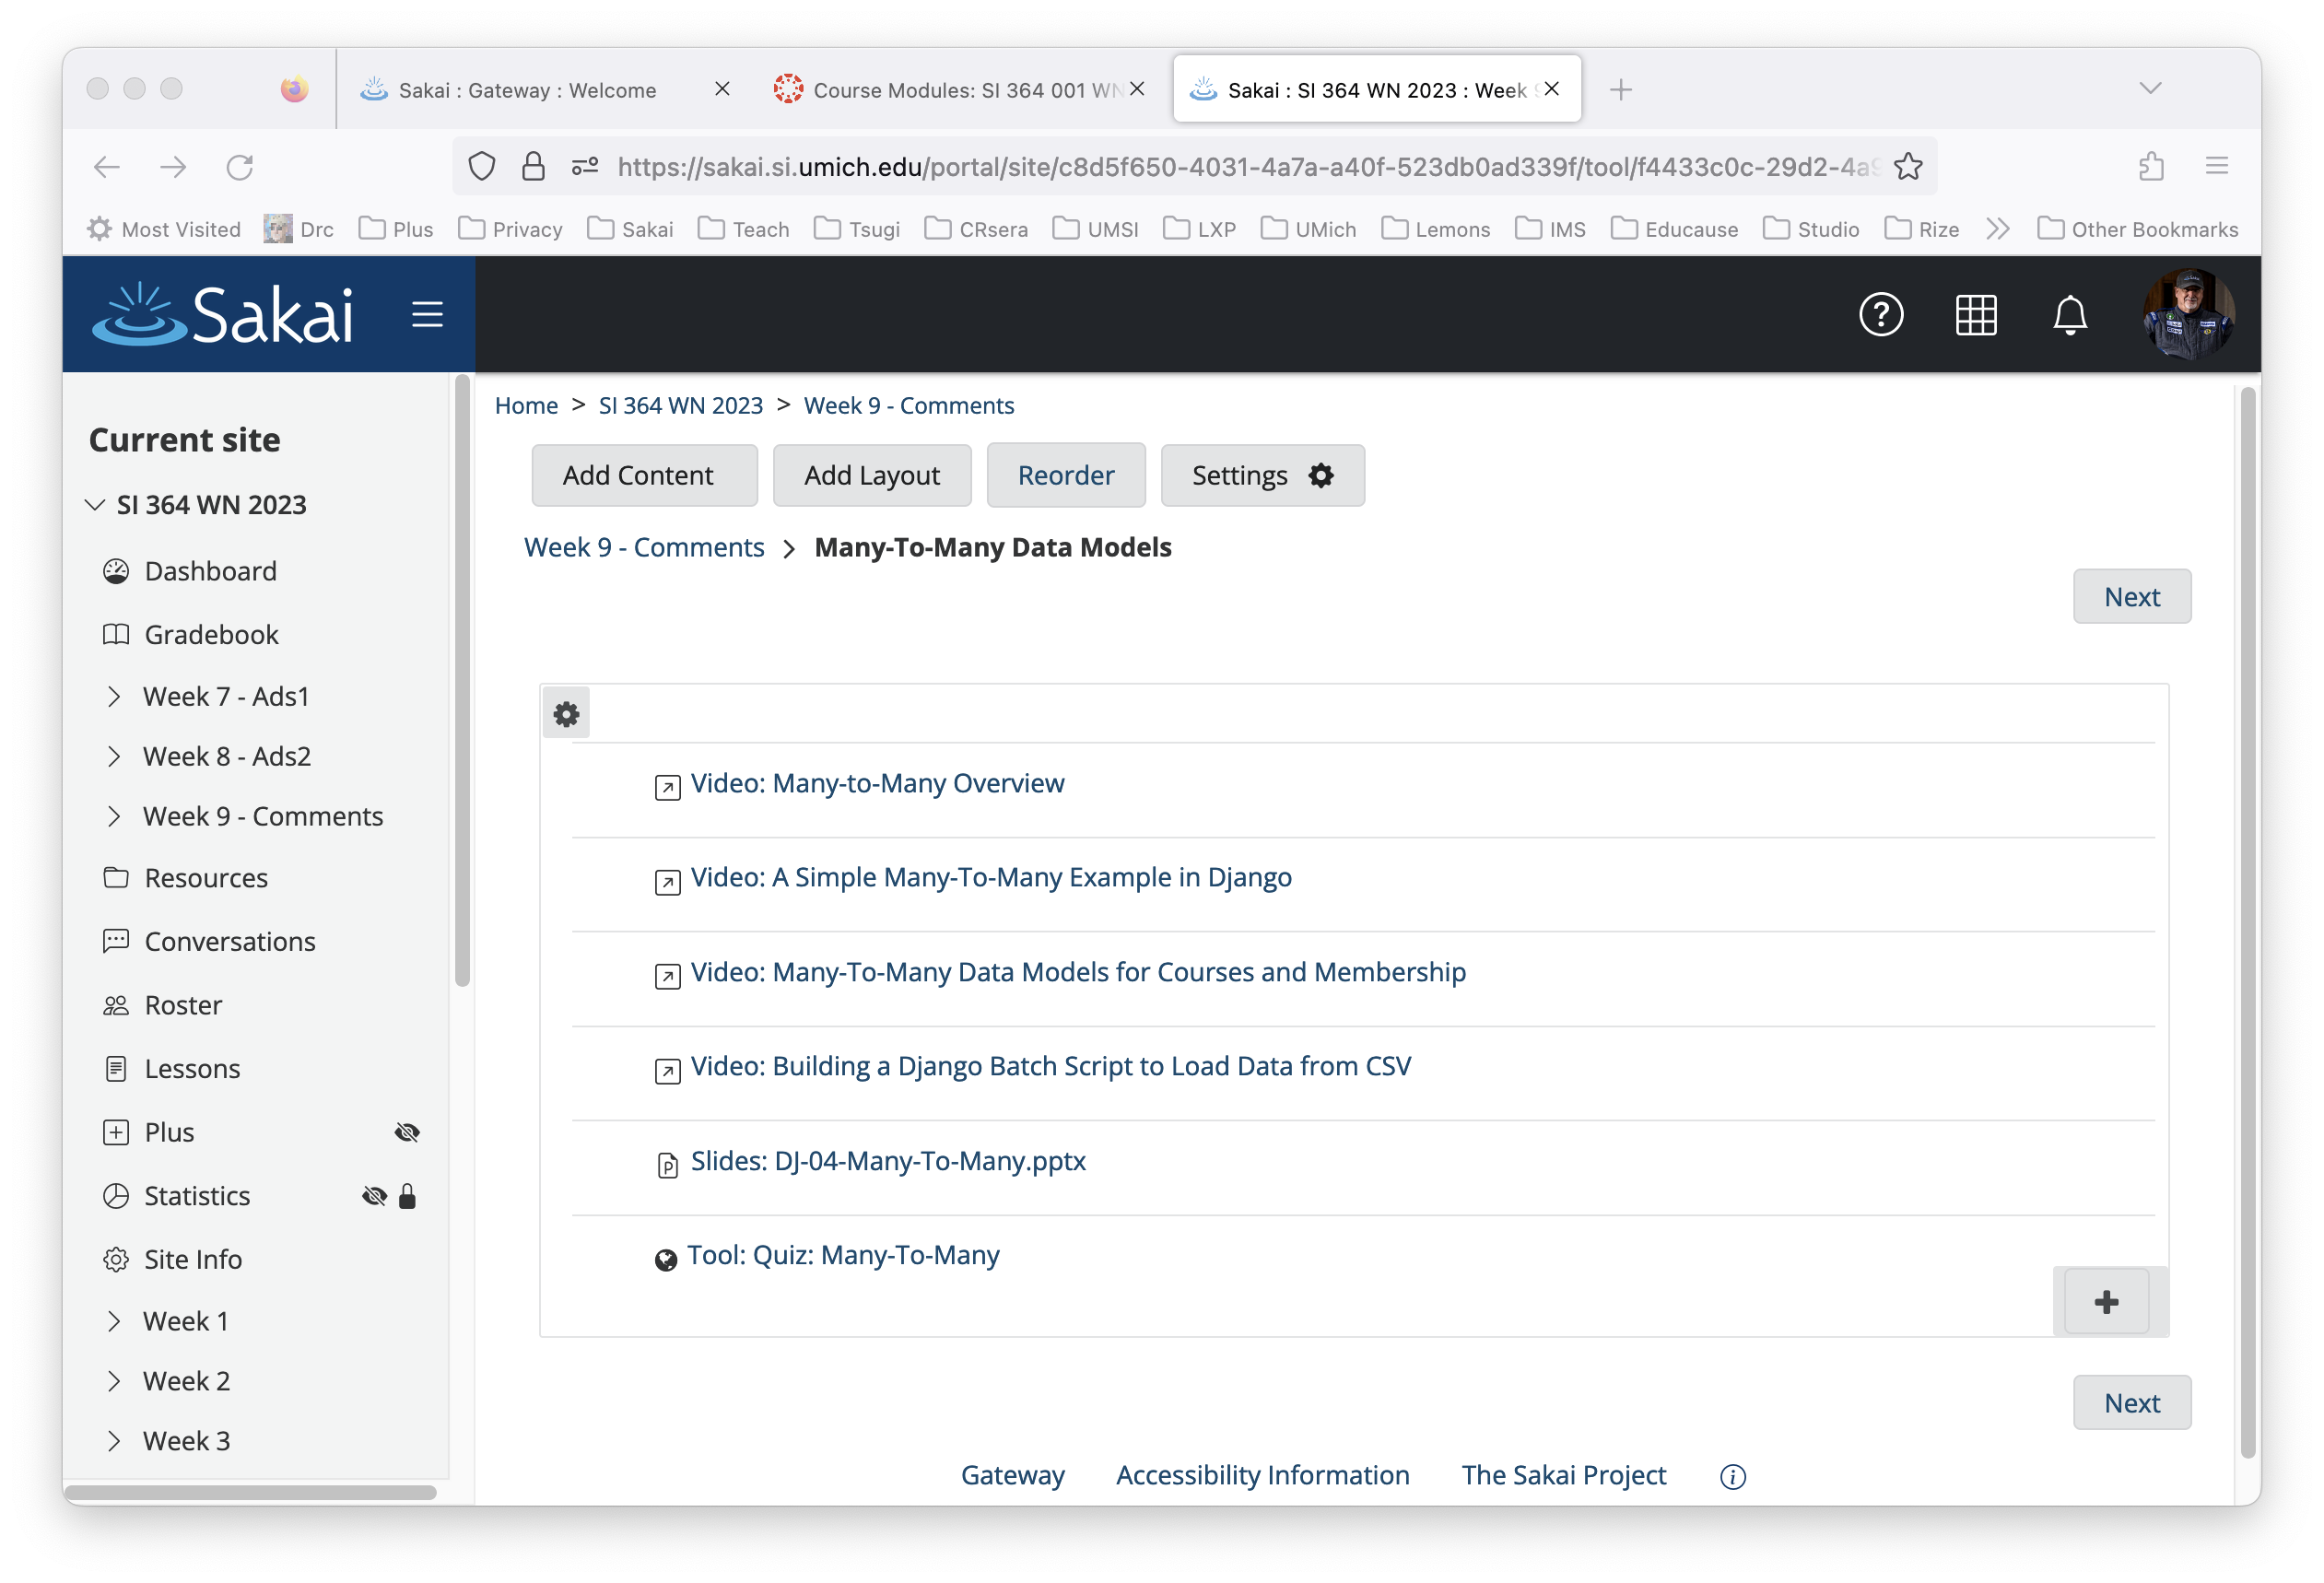

Slide 11
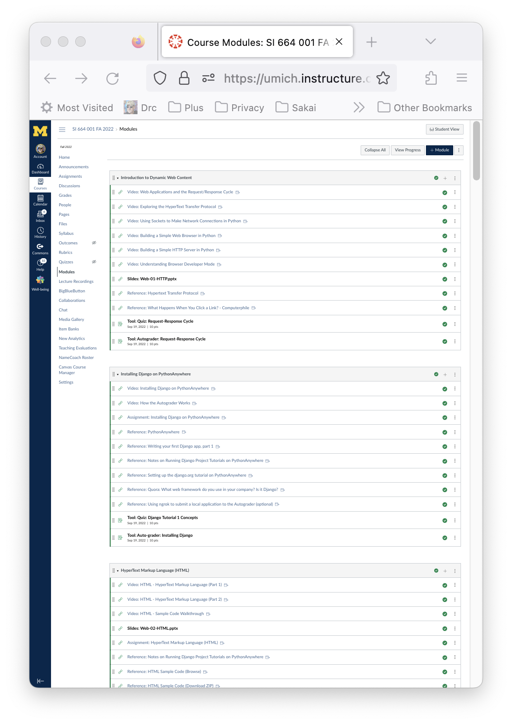
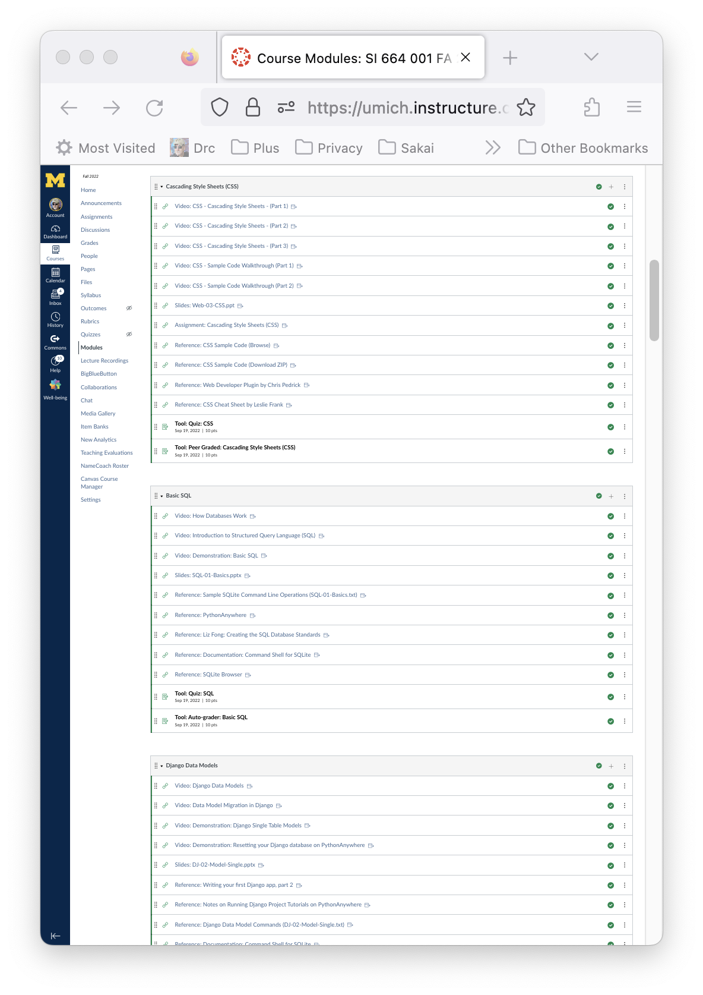
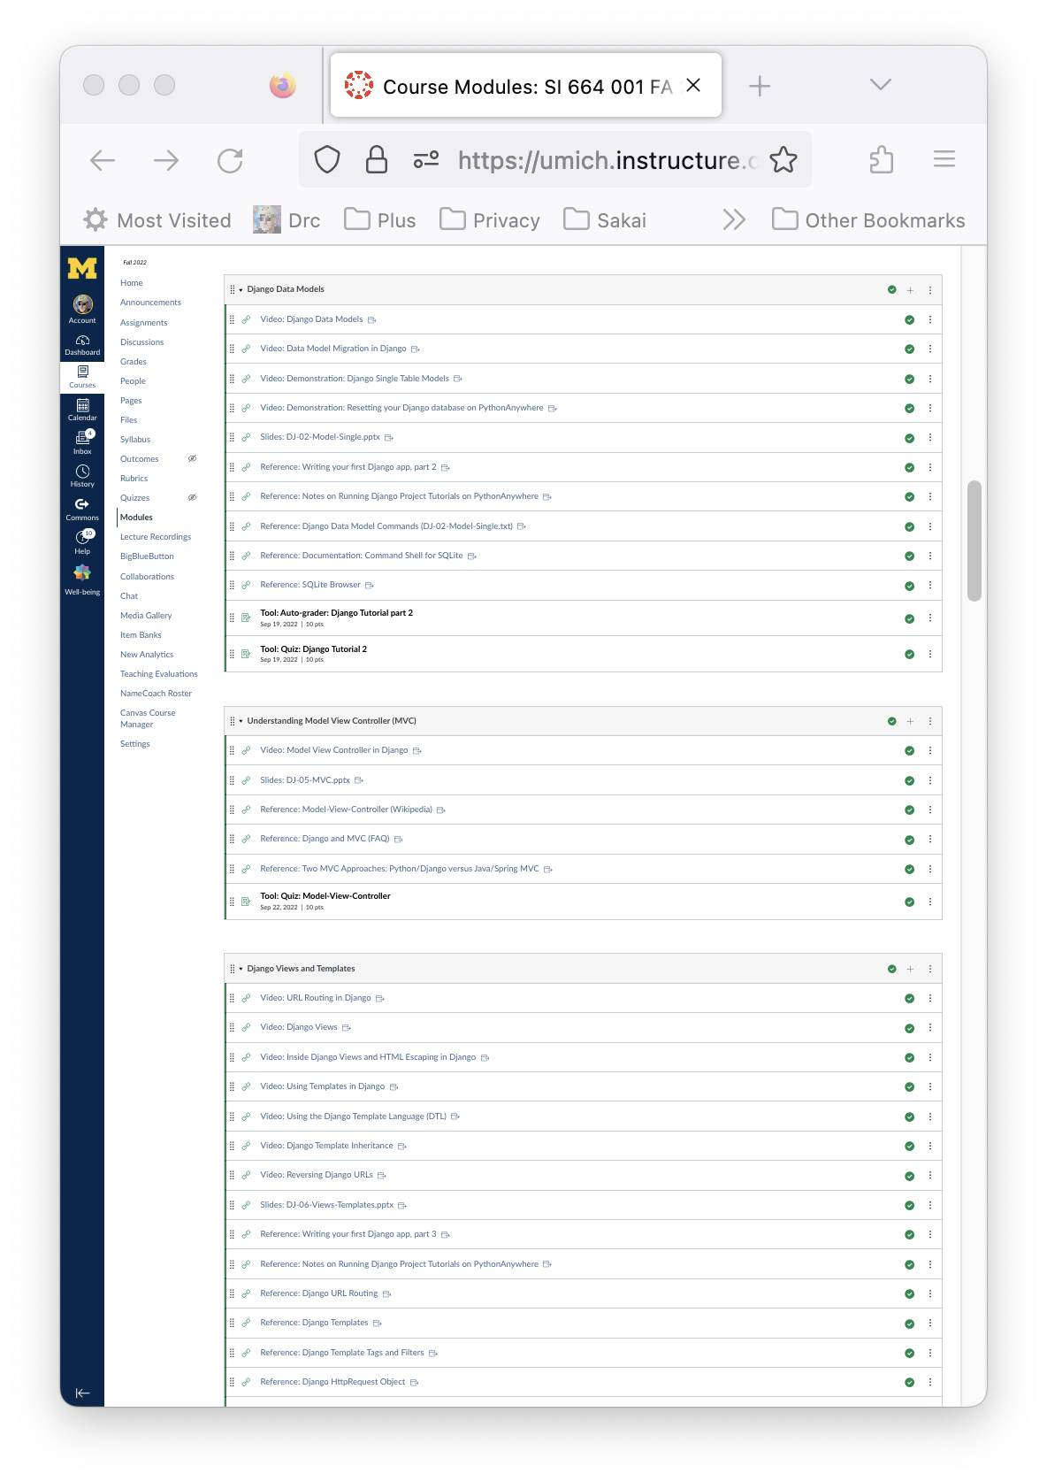
My Fall 22 Modules in Canvas (1/3)

Slide 12

Campus IT Perspective
From the Campus IT perspective, this is a single LTI tool
The "new vendor" meetings 3-4 hours Summer 2033
Help with the integration (1 hour back in Sept 2022)
Happy faculty member

Slide 13

Instructor Perspective
I am teaching the way I like
I have much more control over the student UX because of Lessons
I am not stuck in an LMS that will never change or grow.

Slide 14

Student Perspective
Zero complaints
Students picked it up right away
They use resources outside the LMS across many classes - this was like a publisher site associated with a book
They used Sakai features like the Tasks tool

Slide 15
My Future Research - > 1 LMS
My goal is to pave the way for multiple LMS systems on a campus
I am adding a light LMS capability my Tsugi Learning Object Repository so can teach right in my learning object repository
I am working with a grad student and trying to convince her to build a prototype Virtual Reality LMS and plug it using LTI Advantage

Slide 16
Summary
More information
Plus @sakailms.org
Beta server
https://plus.sakaiclud.com
Let's do some beta testing over the summer.

